Slide 1
Week 2
Group 5

Slide 2
Gantt chart update
Mainly on schedule

Slide 3
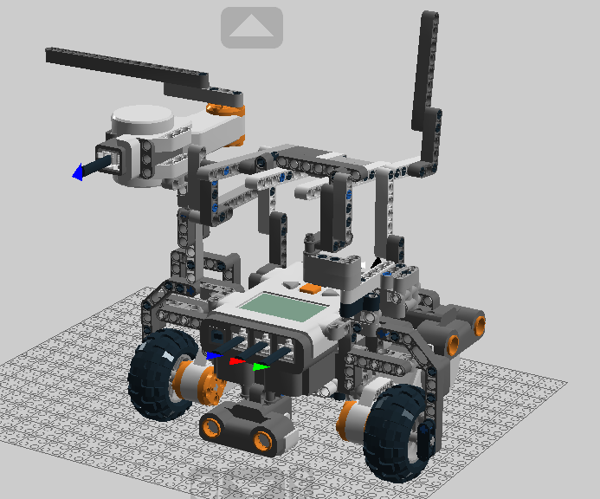
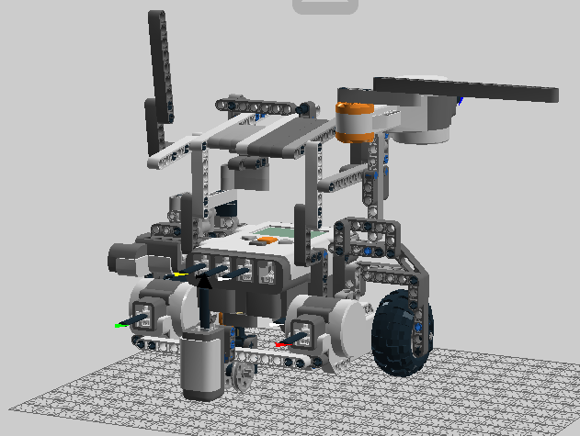
Mechanical design
Front
Back

Slide 4
Mech design
Brick
Ultrasonic Sensor
FrontUS
SideUS
Light Sensor
Cardboard
Motors
Drive Motors
Launcher

Slide 5
Software design
Odometer
Obstacle Avoidance
Navigation
Localization

Slide 6
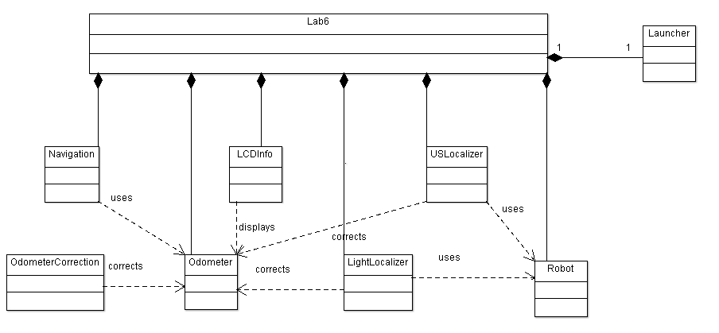

Slide 7
Testing
Loading and Launching
Mechanical Design
Navigation and Obstacle Avoidance
Localization
Integration
Ultrasonic Sensor
Light Sensor
Speed

Slide 8
Plans for next week
Calibration
Testing
Time for changes
Mech – LDD
Software – Class Hierarchy, API

